Slide 1

VILLAMIN WOOD AND IRON WORKS
ONLINE STORE
By MLNSD

Slide 2




THE TEAM
MLNSD MEMBERS
Leigh Curtis Camara
Ludwig Marco Angeles
Mabelle Aspeli
MLNSD

Slide 3



THE TEAM
MLNSD MEMBERS
Felino III Calderon
Dale Joshua Domingo
Nathaniel Sison
MLNSD

Slide 4



THE TEAM
MLNSD MEMBERS, THE CONSULTANT, and THE ADVISER
Sofia Emmanuelle Villamin
Mr. Jayvee Cabardo
Mr. Jojo Castillo
MLNSD

Slide 5

Assets are cited to pexels.com with Royalty Free License

Slide 6


INTRODUCTION
The project is created by the MLNSD team under the Project-Based Learning (PBL) program. The team looked for an actual client for the project to help them develop their PBL experience, and to help the client solve their business problem/s.
Villamin Wood and Iron Works
Online Store
MLNSD

Slide 7

This project will help the business of Villamin Wood and Iron Works an opportunity to better expose the image of the company and to expand their business’s credibility. Also, to increase the sales of their product because of its effective marketing tool to connect directly to their customers, gives opportunities to gain experience about the customers' preferences and improve the overall business model. There is a need to use internet to capture orders and train the owners and his staff to manage and administer the website. This project will not address any additional issues that are not directly related to the company's sales or its market reach.
SCOPE AND LIMITATIONS

Slide 8
COMMENT MATRIX
COMMENT
RESPONSE
1. Use Case Diagram:
Must have UPDATE PRODUCT
Separate CREATE AND UPDATE ACCOUNT
Manage order and manage inventory is related and must be connected.
Refer to this presentation
2. Wrong usage of <<include>> and <<extend>> in Use Case Diagram
3. Use Case Full Description:
a. Second line called Scenario, can you create and update an
account at the same time? Do you have the same set of
actions?
b. Under manage account, add customer cannot create
account if the email exists in the database.
Refer to the paper
4. Raw materials have different database.

Slide 9
COMMENT MATRIX
COMMENT
RESPONSE
4. Connect manage order to manage inventory
5. Customer inquiry does not exist in Activity Diagram

Slide 10


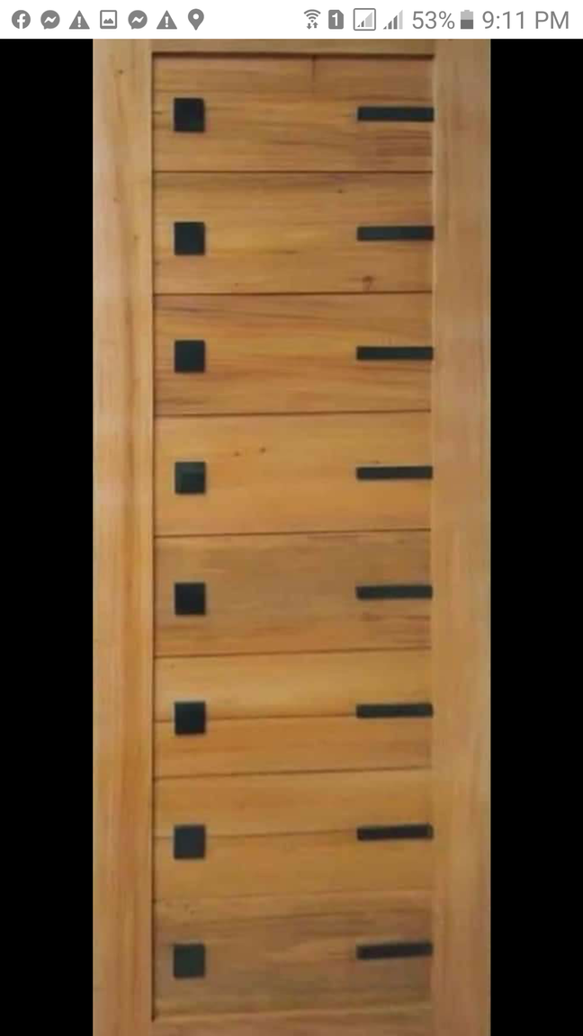
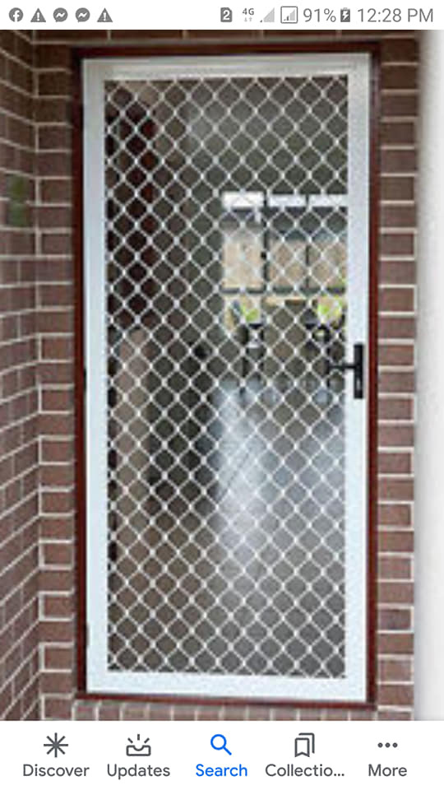


DIAGRAMS
MLNSD

Slide 11
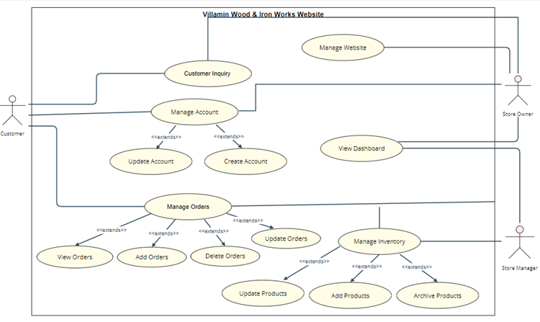
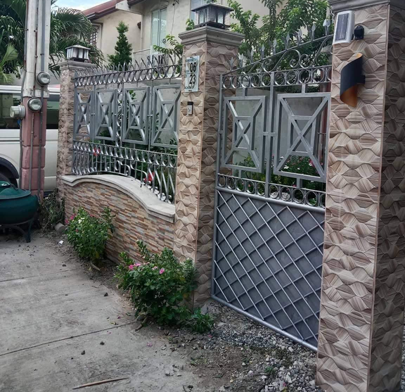
USE CASE DIAGRAM
(UCD)
MLNSD

Slide 12
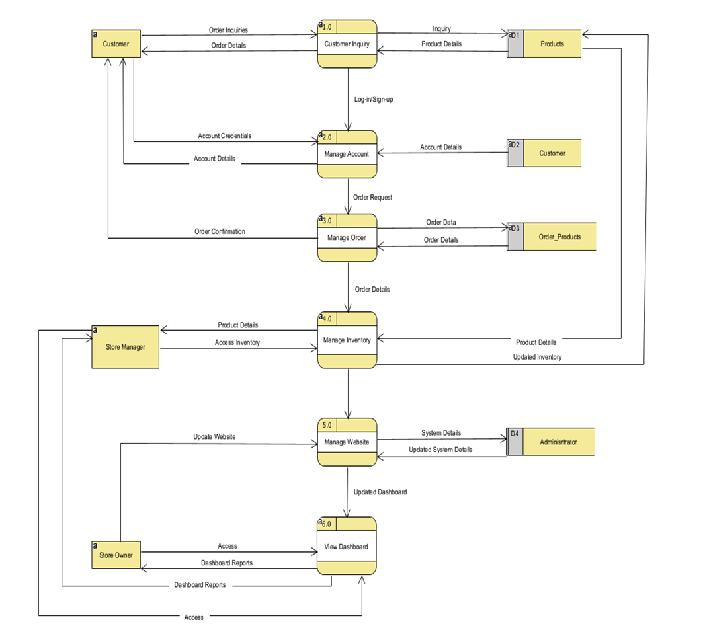

DATA FLOW
DIAGRAMS
(DFD)
LEVEL 0
MLNSD

Slide 13
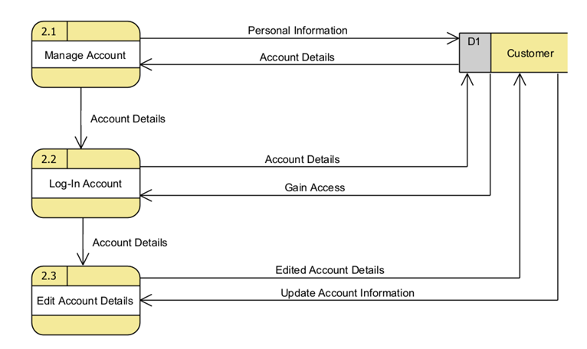

DATA FLOW
DIAGRAMS
(DFD)
LEVEL 1 - MANAGE ORDER CUSTOMER
MLNSD

Slide 14
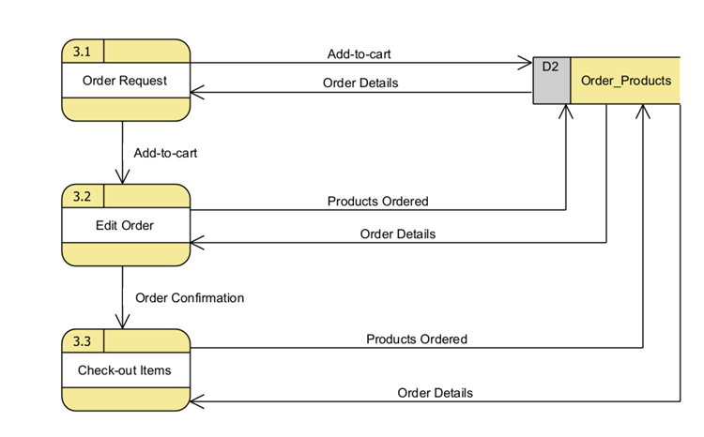

DATA FLOW
DIAGRAMS
(DFD)
LEVEL 1 - MANAGE ACCOUNT CUSTOMER
MLNSD

Slide 15
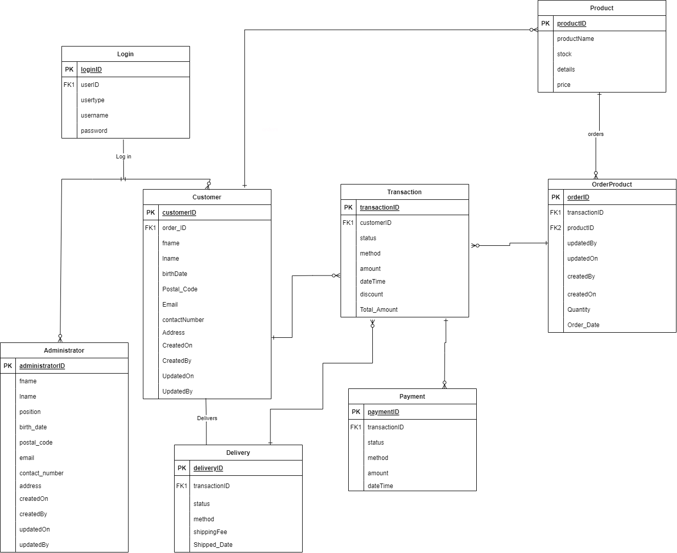

ENTITY-
RELATIONSHIP
DIAGRAM
(ERD)
MLNSD

Slide 16
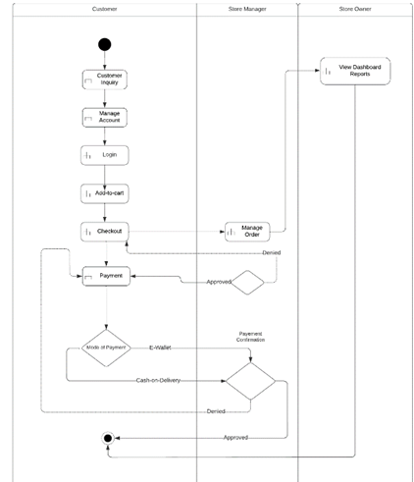
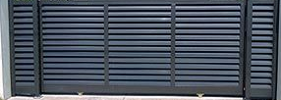
ACTIVITY
DIAGRAM
MLNSD

Slide 17

THANK YOU!
MLNSD
MYSADD1

